Slide 1
Tore Alden Principal Analyst The Jacobsen
The Impact of the Expansion of Renewable Fuel Capacity on Protein Meal and Feed Grain Markets
Notes:
Journey of transformation
Introductions to co presenters
Housekeeping & phones

Slide 2
Smaller Safrinha production in Brazil provides opportunities for US exports, but tight stocks and strong basis levels keep shipments below 2020/21.
Ethanol production not expected to recover to pre-pandemic levels for at least the next two years.
Tight stocks begin to ease after 2021/22. However, rising fertilizer prices and strong demand for soybeans could limit acreage expansion.
Fastmarkets | Agricultural Forecasting

Slide 3
In 2021, acreage for three major row crops rose to the highest level since 1980.
The Biden administration is incentivizing an increase in CRP acreage, potentially limiting growth in combined acreage in the coming years.
A reduction in wheat stocks should keep wheat competitive and slow the long-term decline in wheat acres.
Fastmarkets | Agricultural Forecasting

Slide 4
Ethanol production has recovered from the pandemic but remains lower than it has been in recent years.
The Jacobsen assumes the EPA will set the 2020 and 2021 ethanol mandates at levels close to production. However, it is unclear whether they can use exemptions to reduce the overall mandate enough to set the ethanol mandate at that level.
The slowdown in ethanol production will keep DCO output relatively steady over the next several years, limiting the availability of a key feedstock for biomass-based diesel.
Fastmarkets | Agricultural Forecasting

Slide 5
Following a slow start to U.S. shipments exports should exceed last year’s pace during the first half of the marketing year.
Early Brazilian plantings suggests a recovery in safrinha production in 2022, slowing export demand in the second half of the year.
Fastmarkets | Agricultural Forecasting

Slide 6
An expansion in planted area and return to more normal yields could result in record Brazilian production in 2022.
While domestic use remains strong, the recovery in the crop allows exports to potentially rise to a record level in 2022/23.
Depreciation in the Brazilian real, which has fallen to record low levels in recent years, and the rally in corn prices has more than tripled the price Brazilian farmers receive compared to 2017.
Fastmarkets | Agricultural Forecasting

Slide 7
Brazilian shipments well below last several years due to crop shortfall but expected to recover next year.
Corn prices in destination markets remain strong, due, in part, to the limited supply from Brazil and slowdown at U.S. Gulf.
Limited availability from the U.S. and Brazil leave Argentina as primary source of corn in the short term.
Fastmarkets | Agricultural Forecasting

Slide 8
Strong demand from importing countries could increase exports from The Jacobsen’s assumptions.
Argentina’s government limited further sales of old-crop corn after export licenses reached 38.6 million tonnes. However, low river levels could impact shipments.
Strong exports encouraging expansion of corn acreage.
Fastmarkets | Agricultural Forecasting

Slide 9
Argentine planting slightly ahead of last year’s pace and was a little more than 21 percent complete as of October 8.
Multi-year expansion of corn acreage expected to continue in 2022. However, bullish world vegetable oil fundamentals could encourage a shift from corn to soybeans in the coming years.
Fastmarkets | Agricultural Forecasting

Slide 10
Recovery in feed demand and rebuilding of stocks lead to a sharp increase in Chinese corn imports in 2020/21.
The Jacobsen expects Chinese imports to remain strong in the coming years. However, the Chinese government may release reserves to combat food inflation.
This spring, the Chinese government encouraged hog farmers to utilize alternative feeds due to the high cost of corn.
Fastmarkets | Agricultural Forecasting

Slide 11
A reduction in DDG imports, and recovery in demand, triggered the surge in Chinese corn imports.
Alternative feed usage increased sharply in 2020/21 and The Jacobsen expects it to continue in the coming years, despite its expectation that Chinese corn imports will remain elevated.
The Chinese corn premium has risen from a low of $1.59 per bushel in early May to $3.07 in early October.
Fastmarkets | Agricultural Forecasting

Slide 12
The soybean meal market will be driven by the surge in soybean oil production in response to the expansion in renewable diesel capacity.
The key question in the coming years is what to do with all the soybean meal. The Jacobsen has added the additional supply to exports, but there is a limited market, which may limit shipments.
Fastmarkets | Agricultural Forecasting

Slide 13
Growth in the demand for soybean oil from the biofuel industry is expected to double in 2021/22.
The growth in soybean oil demand could be constrained by crushing and refining capacity.
Uncertainty surrounding the RFS mandates and the sharp increase in the spread between RBD and crude soybean oil prices slowed demand over the summer. However, the drop in the HOBO spread has driven a recovery in recent months.
Fastmarkets | Agricultural Forecasting

Slide 14
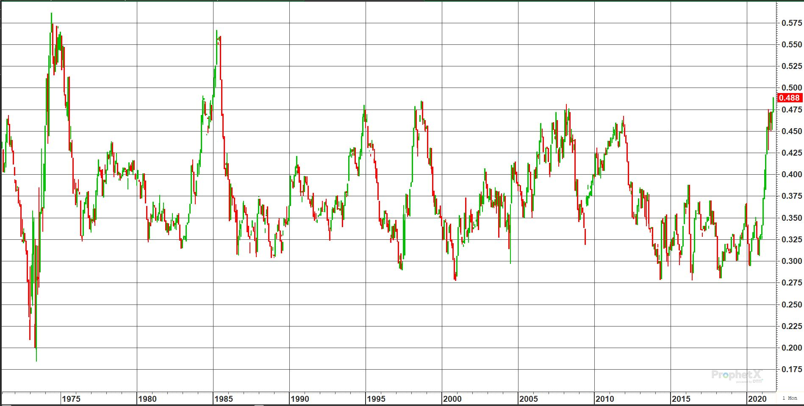
Monthly Soybean Oil Share for Continuous Most Actively Traded Contract
The key question for soybean meal prices is what price will it take to clear the market.
Oil share has risen to nearly 50 percent, which was resistance during the initial build out of biodiesel capacity. However, The Jacobsen expects it to rise to a level where crushers are “crushing for oil.”
Soybean meal prices could effectively trade at energy parity to corn.
Fastmarkets | Agricultural Forecasting

Slide 15
HPAU has been relatively steady over the last several years. Rising prices could encourage expansion, but feed costs may limit any increase in animal numbers.
If HPAUs remain steady, soybean meal prices could drop below $200 per tonne in 2021/22 or 2022/23.
As the pandemic ends, a drop in at home eating will likely reduce the demand for chicken, slowing domestic soybean meal demand.
Fastmarkets | Agricultural Forecasting

Slide 16
The Jacobsen expects the expansion in Argentine production and recovery in Brazilian yields to pressure corn prices in 2022.
The key risk to The Jacobsen’s outlook is U.S. acreage. If corn prices do not encourage steady U.S. plantings next spring, tightening stocks could increase upside price risk.
Opportunities for farmer hedging may limit the impact of falling prices in 2022, but rising soybean oil demand will require growing soybean acreage over the next couple years.
Fastmarkets | Agricultural Forecasting

Slide 17
The Jacobsen projects relatively steady soybean meal prices, but there is substantial downside risks to its outlook.
If soybean prices drop substantially from current levels, the bulk of the decline will be borne by soybean meal futures.
A significant drop in soybean meal prices at the Gulf could increase U.S. competitiveness relative to Argentina.
Fastmarkets | Agricultural Forecasting

Slide 18


Questions?
Fastmarkets | Agricultural Forecasting

